Slide 1
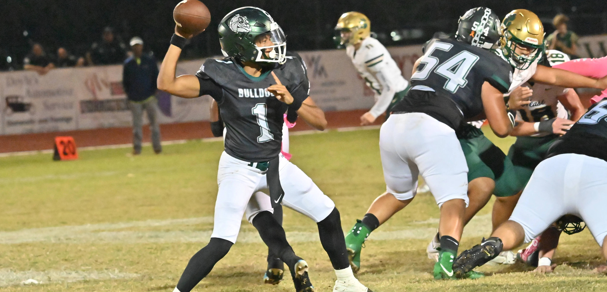
How does QB performance affect the chances of winning the game?

Slide 2

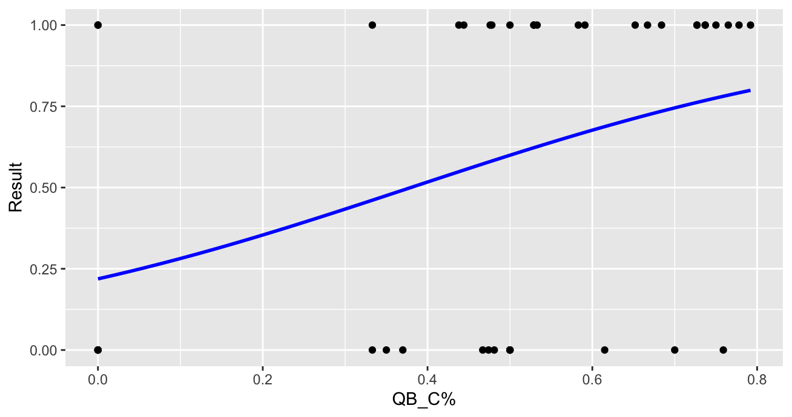

QB Completion %
For every 1% increase in completion percentage, we would expect an approximate 3.35% increase in win %.

Slide 3
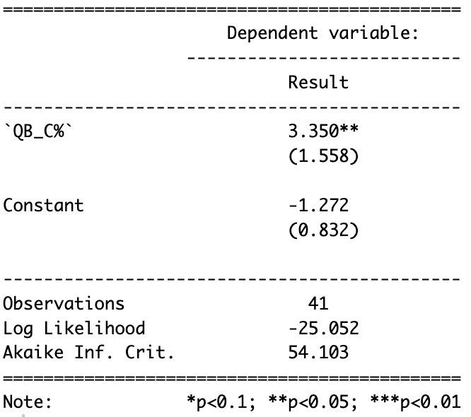








log-odds = $\text{−1.272 + 3.350 ∗ }\text{QB}\text{_}\text{C}\text{\%}$
$$−1.272+\left(3.35 ∗.50\right)=0.403$$
$$\text{P}\text{(}\text{win}\text{) = }\frac{1}{1+e^{(−log−odds)}}$$
$$\frac{1}{1+e^{−0.403}}=0.60$$
When QB completes 50% of his passes, the team is expected to have a 60% chance of winning the game.
log-odds = $\text{−1.272 + 3.350 ∗ }\text{QB}\text{_}\text{C}\text{\%}$
$$−1.272+\left(3.35 ∗.70\right)=1.073$$
$$\text{P}\text{(}\text{win}\text{) = }\frac{1}{1+e^{(−log−odds)}}$$
$$\frac{1}{1+e^{−1.073}}=0.75$$
When QB completes 70% of his passes, the team is expected to have a 75% chance of winning the game.

Slide 4
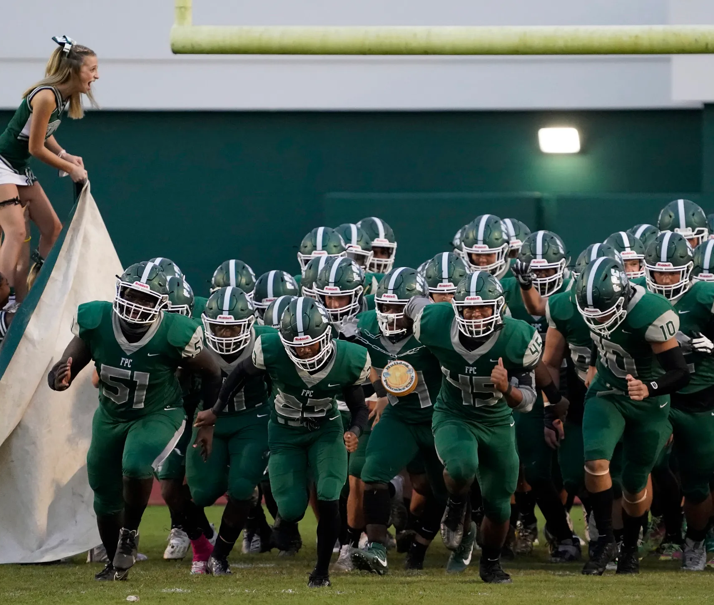
In what situations should the offense go for it on 4th down?

Slide 5
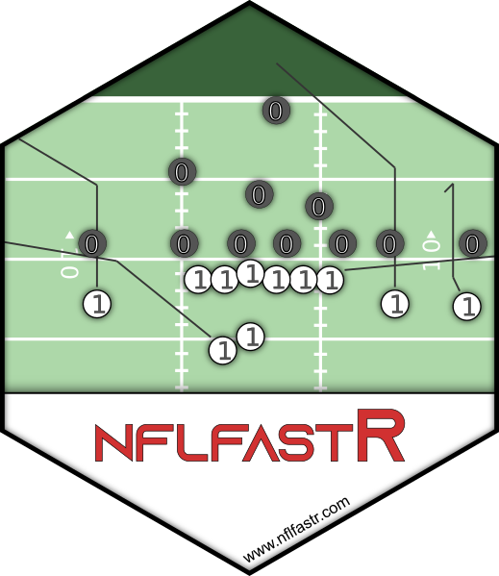
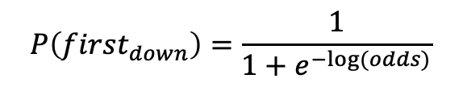
General Model
NFL 2024 season data:
Play-by-Play for every game
Created `success` variable that determines if the play was either a 1st down or touchdown.
Generated model to predict the probability of getting a first-down based on different factors at a point in the game.
$$\log\left(odds\right)=0.748 −0.013\left(distance_{to_{EZ}}\right)−0.345\left(yds_{to_{go}}\right)−0.044\left(score_{differential}\right)−0.0003(game_{seconds_{remaining}})$$
$$P\left(first_{down}\right)=\frac{1}{1+e^{−log⁡(odds)}}$$

Slide 6
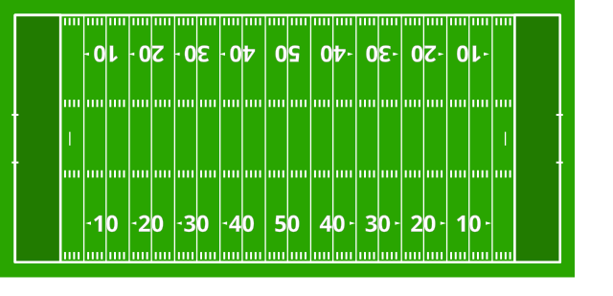


When the game is tied, there is a 10.92% chance of converting a 4th down and 4 attempt at the 50-yard line.
FLAGLER
BULLDOGS
$$\log\left(odds\right)=0.0748−0.013\left(50\right)−0.345\left(4\right)−0.044\left(0\right)−0.0003\left(480\right)=−2.0992$$
$$P\left(first_{down}\right)=\frac{1}{1+e^{2.0992}}=0.1092$$

Slide 7
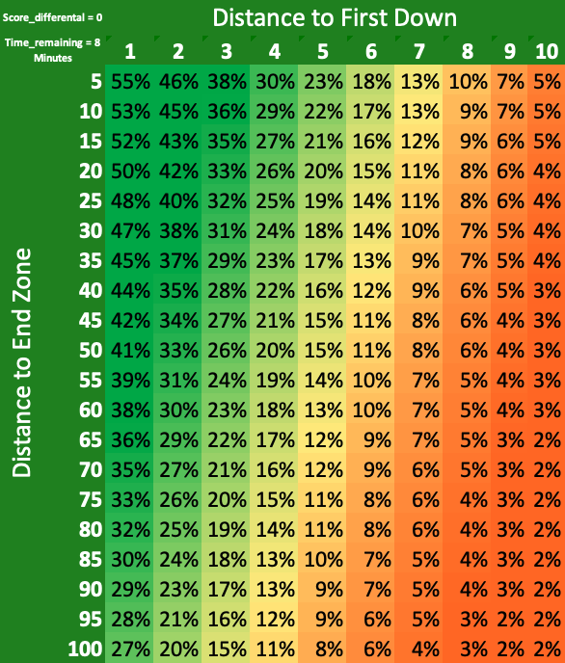

Slide 8
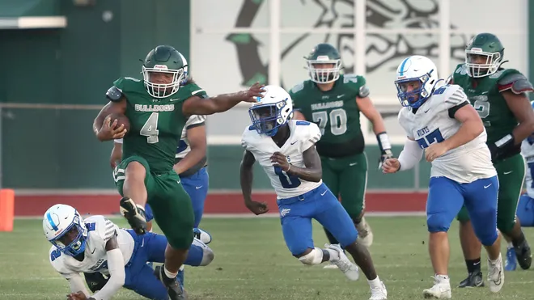

Slide 9
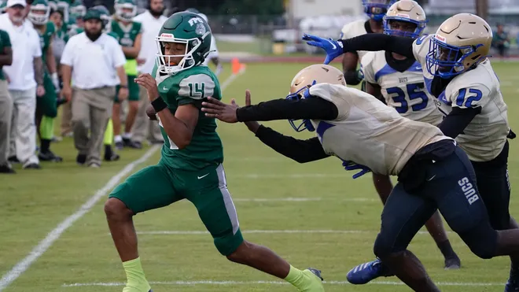

Slide 10
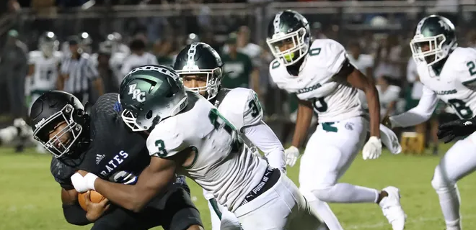

Slide 11
